Slide 1
Prediction of disulfide-bonded cysteines in proteomes with a hidden neural network
Pier Luigi Martelli, Piero Fariselli and Rita Casadio
Proteomics 2004, 4, 1665–1671 DOI 10.1002/pmic.200300745
Presenter : Chih-Ying Lin
Date : June 30, 2009

Slide 2
Abstract
A hidden neural network-based method is used to predict the bonding state of cysteines starting from the residue sequence of the protein chain. The method scores as high as 89% and 86% per cysteine residue and per protein, respectively, and in this overcomes other predictors of the same category. We then explore the efficacy of our predictor in computing the disulfide content of the whole proteome of Escherichia coli (K12 and O157), Aeropirum pernix, Thermotoga maritima, and Homo sapiens. We find that the percentage of extracellular disulfide containing proteins is higher than that of intracellular one, and that the human proteome is by far the one with the highest content of sulfur-sulfur linkages in proteins.

Slide 3
Database
PDB database July 2003 release(sequence identity < 25%)
1631 chains of known structure for a total sum of 412049 residues
436 proteins contain disulfide bonds, and 280 chains are endowed with more than one disulfide bond per chain.
6961 cysteine residues are present in the set. The total number of disulfide-bonded cysteines is 2308 (33%), and the number of free cysteines is 4653 (67%).

Slide 4
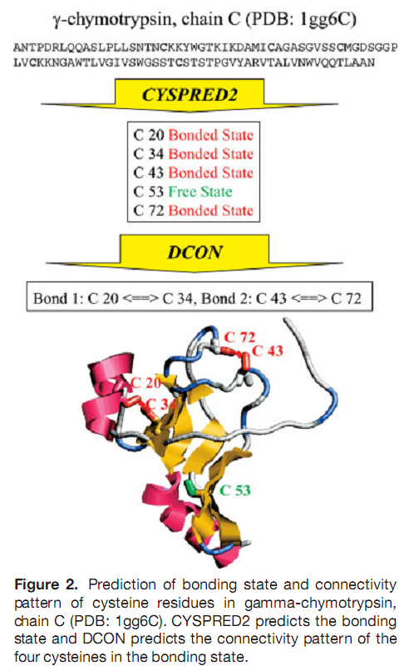

Slide 5
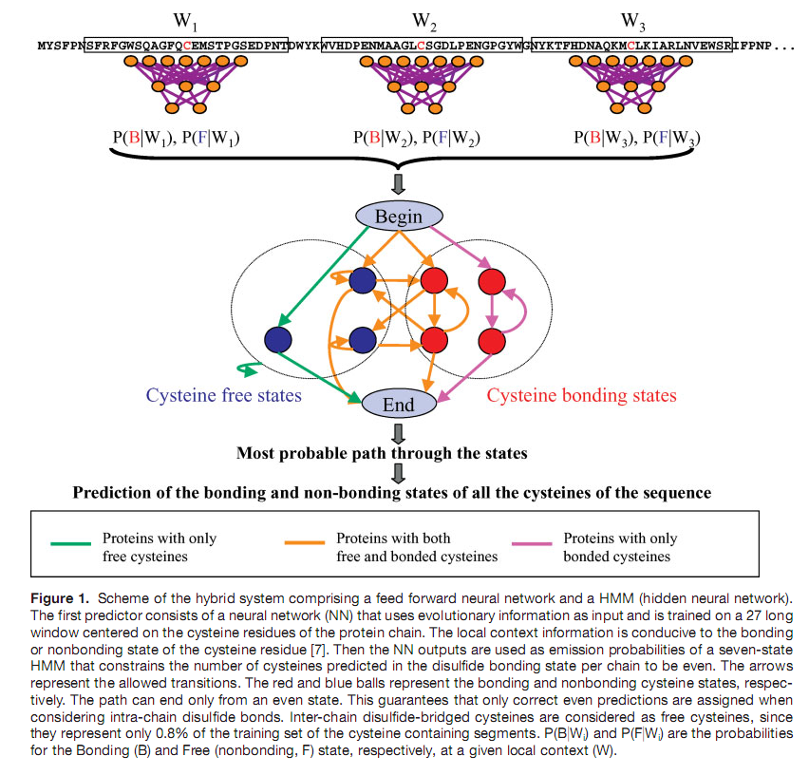

Slide 6
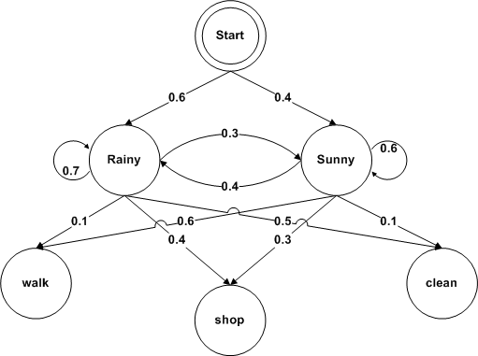
Hidden Markov Models
states = ('Rainy', 'Sunny')
observations = ('walk', 'shop', 'clean')
start_probability = {'Rainy': 0.6, 'Sunny': 0.4}
transition_probability = { 'Rainy' : {'Rainy': 0.7, 'Sunny': 0.3}, 'Sunny' : {'Rainy': 0.4, 'Sunny': 0.6}, }
emission_probability = { 'Rainy' : {'walk': 0.1, 'shop': 0.4, 'clean': 0.5}, 'Sunny' : {'walk': 0.6, 'shop': 0.3, 'clean': 0.1}, }

Slide 7
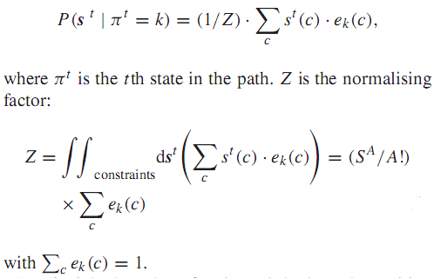
Hidden Markov Models
s = s¹s²...s^{L}=[s¹(1), s¹(2)] [s²(1), s²(2)]...[s^{L}(1), s^{L}(2)]
s^{t}=[NN(B,W), NN(F,W)]

Slide 8
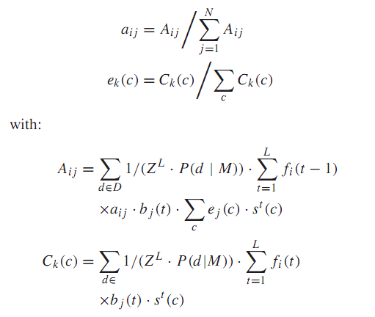
Expectation-maximization algorithm for sequence-profile-based HMM
d are the sequences of the training set D
M is the model
fi(t) is the probability of emitting the first t
vectors of the sequence requiring that the
state at the iteration t is k
b_{k}(t) is the probability of emitting the vectors
From the position t+1 to the end of the
sequence

Slide 9
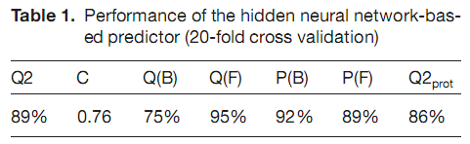
Results
B, cysteine bonding state;
F, cysteine free state;
Q2,number of correctly predicted cysteines/total number of cysteines;
C, correlation index;
Q(class), number of cysteines correctly predicted in class/number of cysteines in class;
P(class), number of cysteines correctly predicted in class/number of cysteines predicted in class;
Q2prot, number of proteins correctly predicted/ total number of proteins.

